Slide 1
Computer Architecture & Cloud Computing
Lecturer: Jackie Stewart
Room: X309
Email :
jackie.stewart@tus.ie
Lecture 3.2
9-<number>

Slide 2
Virtualization
Virtualization is a crucial concept in computer science and software engineering.
It is the creation of a virtual version of something such as hardware, operating systems, storage devices, or network resources, within a software environment.
It facilitates multiple instances or copies of the same resource to coexist and operate independently on a single physical machine.
2-<number>

Slide 3
Virtualization
Although virtualization exists for years, advances in this data centre technology have been significant in the last number of years.
Many different types of virtualization:
    Network Virtualization
    Desktop Virtualization
    Operating system Virtualization
    Storage Virtualization
    Memory Virtualization
    Server virtualization
1-<number>
Notes:
In computing, virtualization means to create a virtual version of a device or resource,
such as a server, storage device, network or even an operating system
where the framework divides the resource into one or more execution environments.

Slide 4
Virtualization
Network Virtualization:
Network Virtualization creates virtual networks on top of physical networks.
It enables the isolation and segmentation of network traffic for different purposes –
Concepts like Virtual LANs (VLANs) and Virtual Private Networks (VPNs) and Software Defined Networking (SDN).
VLAN – helps to segment traffic and provide “isolation” by compartmentalising the network.
VPNs can be used to create secure connections between cloud entities, enterprises, end users and even service providers.
1-<number>
Notes:
VLANs allow network administrators to partition their networks to match the functional and security requirements of their systems without having to run new cables or make major changes in their current network infrastructure.
IEEE 802.1Q is the standard defining VLANs; the VLAN identifier or tag consists of 12 bits in the Ethernet frame, creating an inherent limit of 4,096 VLANs on a LAN.

Slide 5
Virtualization
Desktop virtualization is the concept of separating the logical desktop from the physical machine.
Often used in enterprise environments, allows remote access to virtual desktops hosted on a central server.
Users can access their desktop environment from various devices from anywhere
Operating system-level virtualization, hosting of multiple virtualized environments within a single OS instance.
Facilitates multiple isolated environments or containers to run on a single operating system instance.
Containers share the host OS kernel but have their own user spaces, making them lightweight and efficient.
Examples: Docker and Kubernetes.
1-<number>
Notes:
Desktop virtualization is a method of simulating a user workstation so it can be accessed from a remotely connected device. By abstracting the user desktop in this way, organizations can allow users to work from virtually anywhere with a network connecting, using any desktop laptop, tablet, or smartphone to access enterprise resources without regard to the device or operating system employed by the remote user.
Remote desktop virtualization is also a key component of digital workspaces virtual desktop workloads run on desktop virtualization servers which typically execute on virtual machines (VMs) either at on-premises data centres or in the public cloud.
Since the user devices is basically a display, keyboard and mouse, a lost or stolen device presents a reduced risk to the organization. All user data and programs exist in the desktop virtualization server, not on client devices. (from VMWare).

Slide 6
Virtualization
Storage virtualization, the process of completely abstracting physical storage resources and presenting them as a single pool of storage
It facilitates for easier management, scalability and improved utilization of storage resources.
Memory Virtualization; abstracting volatile memory and mapping it to pooled resources.
Application Virtualization; allows applications to run in isolated environments, ensuring they do not interfere with each other.
This is useful for maintaining compatibility when different applications have conflicting requirements or dependencies.
1-<number>
Notes:
In computer science, memory virtualization decouples volatile random access memory (RAM) resources from individual systems in the data center, and then aggregates those resources into a virtualized memory pool available to any computer in the cluster.
The memory pool is accessed by the operating system or applications running on top of the operating system.
The distributed memory pool can then be utilized as a high-speed cache, a messaging layer, or a large, shared memory resource for a CPU or a GPU application.

Slide 7
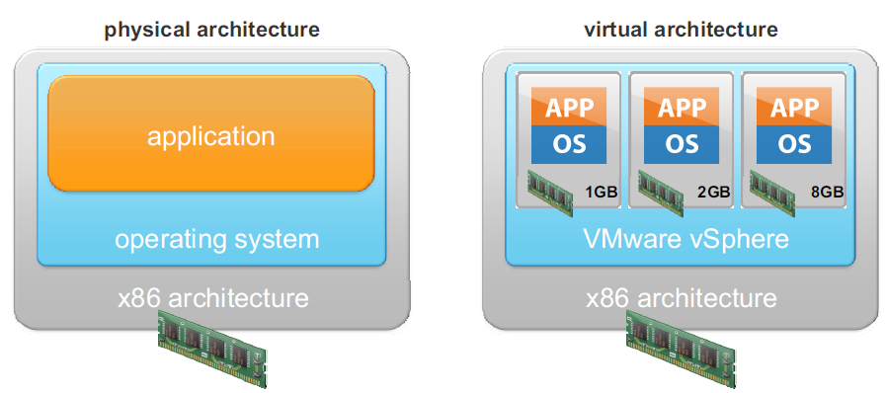
Virtualization
Memory Virtualization: abstraction and management of a computers physical memory (RAM); typically managed by an Operating System or Hypervisor in the context of Virtual Machines
1-<number>
Notes:
Oracle VM Virtual Box -

Slide 8
Virtualization
Server Virtualization –
Virtualization software allows one physical server to run several individual computing environments:
This virtualization abstracts the underlying physical resources and presents these as a set of virtual machines – each of these appears as its own physical systems
It is technology that allows multiple virtual servers to run on a single physical server or host
This revolutionized data centre management and IT infrastructure
It provides a very high degree of isolation between guest operating Systems.
There are many kinds of management layers (or hypervisors) that facilitate this abstraction.
1-<number>
Notes:
Physical vs. Virtual Servers:
Physical Servers: Traditionally, each physical server is dedicated to a specific workload or application. This approach can be inefficient, as a server may not utilize its full capacity.
Virtual Servers: Server virtualization enables the creation of multiple virtual servers (also called virtual machines or VMs) on a single physical server.
Each VM operates independently, with its own operating system, applications, and resources.
It appears to users and administrators as if each VM is a separate physical server.
This technology is fundamental to cloud computing. ...
Cloud computing, is an umbrella term that encompasses virtualization.
Server virtualization is a technology that enables efficient and flexible utilization of physical server resources by creating virtual servers or VMs.
It has become a cornerstone of modern data centre management, offering benefits in terms of resource optimization,
cost savings, and improved manageability and scalability.
If you know what a private cloud is and you know the infrastructure of it, you’ve probably heard about hypervisor.
It is the part of the private cloud that manages the virtual machines, i.e. it is the part (program) that enables multiple operating systems to share the same hardware.
Each operating system could use all the hardware (processor, memory) if no other operating system is on.
That is the maximum hardware available to one operating system in the cloud.
Nevertheless, the hypervisor is what controls and allocates what portion of hardware resources each operating system should get, in order every one o them to get what they need and not to disrupt each other.
Type-1, native or bare-metal hypervisors. Thesehypervisors run directly on the host's hardware to control the hardware and to manage guest operating systems. ... VMware Workstation, VMware Player, VirtualBox, Parallels Desktop for Mac and QEMU are examples of type-2 hypervisors.
Type 1 hypervisors:
VMware ESX and ESXi. These hypervisors offer advanced features and scalability, but require licensing, so the costs are higher. ...
Microsoft Hyper-V. ...
Citrix XenServer. ...
Oracle VM. ...
VMware Workstation/Fusion/Player. ...
VMware Server. ...
Microsoft Virtual PC. ...
Oracle VM VirtualBox.

Slide 9
Hypervisor
A critical component of server virtualization is the hypervisor.
It is software that runs on the physical server and manages the creation, allocation, and monitoring of virtual machines.
There are two main types of hypervisors:
Type 1 Hypervisor (Bare-Metal): These hypervisors run directly on the physical hardware without the need for an underlying operating system. Examples include VMware vSphere/ESXi, Microsoft Hyper-V, and Xen.
Type 2 Hypervisor (Hosted): These hypervisors run on top of a traditional operating system, turning it into a virtualization platform. Examples include Oracle VirtualBox and VMware Workstation.
2-<number>

Slide 10
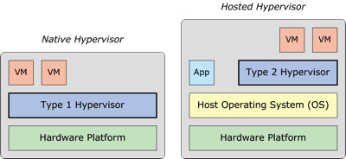
Hardware Virtualization
Two types of hypervisors
  Type 1 for enterprise solutions ( better performance)
  Type 2 small enterprise, individual
Type 1 hypervisors for example: Microsoft Hyper-V or VMWare ESXi runs on bare hardware
Type 2 hypervisors for example: Oracle VirtualBox or VMWare Workstation run on a host operating system. Sits on top of Host OS
2-<number>

Slide 11
Virtualization
Hardware virtualization: the creation of a virtual machine that acts like a real computer with an operating system
Software executed on these virtual machines is separated from the underlying hardware resources
3 layers – colocation, hardware, virtualization
Notes:
Virtualization is not new – IBM mainframes used time-sharing virtualization in the 60s to enable many people to share a large computer without interacting or interfering with each other.
Previously constraints of scheduling dedicated time on these machines required you to get all your work for the day done in that scheduled time slot.
Virtual memory ultimately freed programmers from having to constantly worry about how close they were to the limits of physical memory.
Today, server virtualization is providing equally dramatic for application deployment and scaling and is the key enabler for the cloud.
Colocation: Another possible model for deploying an application is within a third party data centre, otherwise known as a colocation facility.
In this model, the company is still responsible for purchasing the server hardware and developing or purchasing the required software for running the application.
The colocation facility provides that third party with power, cooling, rack space and network connectivity for their hardware.
The colocation facility typicaly also provides redundant network connectivity, backup power and physical security.

Slide 12
Virtualization
Hardware virtualisation separates the OS from the underlying hardware. The OS no longer has to be bound to the PC/ server that it runs on
Virtual Machine (VM) is one type of server virtualization.
Hypervisor is software that enables one or more VMs be run on one physical server.
Multiple instances of VM can be installed on one physical machine – server consolidation, cost reduction
VMs can be ported/cloned to different physical machines that have the same hypervisor…scalability and upgradability

Slide 13
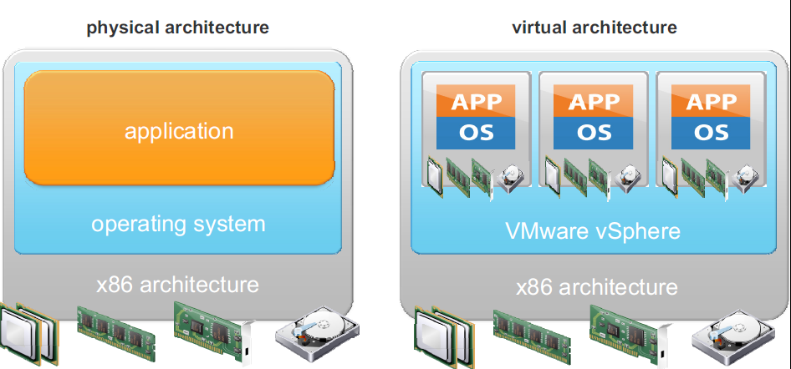
Hardware Virtualization
Virtual Infrastructure Model
Notes:
When virtualization passed testing and being accepted by enterprise architects and CIOs – it had arrived.
It was all about saving money. Enterprises began seeing utilization of their hardware assets increase dramatically. It was easy to go from the typical 5 or 6 percent to 20 percent.
They could get 65 percent utilization or better with good planning.
In addition to increasing utilization and the associated cost savings, virtualization in corporate data centers set the stage for cloud computing in several interesting ways.
It decoupled users from implementations : it brought speed, flexibility and agility never before seen in corporate data centers and it broke the old model of software pricing and licensing.

Slide 14
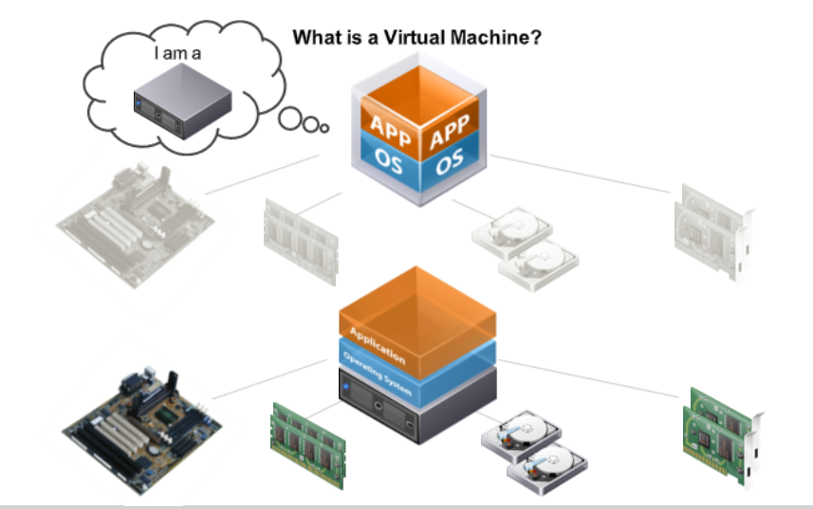
Virtual Machines
Any processes running in VM is limited to the resources of the VM
i.e. It is limited to the RAM etc of the VM
Notes:
Controlling remote servers with a cloud API:
The API is to a cloud what the dashboard and controls are to a car.

Slide 15
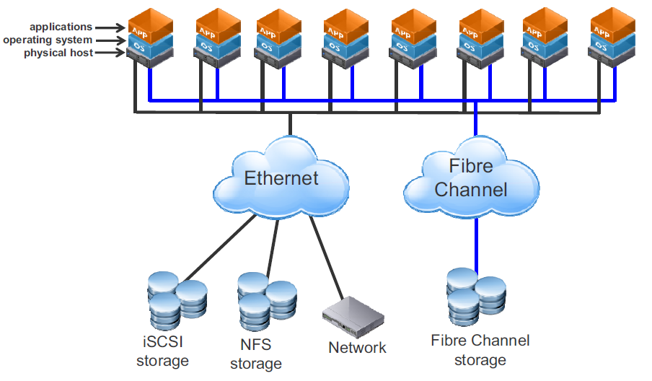
Traditional Model
iSCSI – Internet Small Computer Systems Interface
NFS – Network File System
Traditional Model
1-<number>
Notes:
iSCSI :
In computing, iSCSI is an acronym for Internet Small Computer Systems Interface, an Internet Protocol (IP)-based storage networking standard for linking data storage facilities. It provides block-level access to storage devices by carrying SCSI commands over a TCP/IP network.
NFS:
A network file system (NFS) is a type of file system mechanism that enables the storage and retrieval of data from multiple disks and directories across a shared network. A network file system enables local users to access remote data and files in the same way they are accessed locally. NFS was initially developed by Sun Microsystems.
Fibre Channel Storage:
Fibre Channel (FC) is a high-speed data transfer protocol (commonly running at 1, 2, 4, 8, 16, 32, 64, and 128 gigabit per second rates) providing in-order, lossless delivery of raw block data. Fibre Channel is primarily used to connect computer data storage to servers in storage area networks (SAN) in commercial data centers. Fibre Channel networks form a switched fabric because the switches in a network operate in unison as one big switch. Fibre Channel typically runs on optical fiber cables within and between data centers, but can also run on copper cabling.

Slide 16
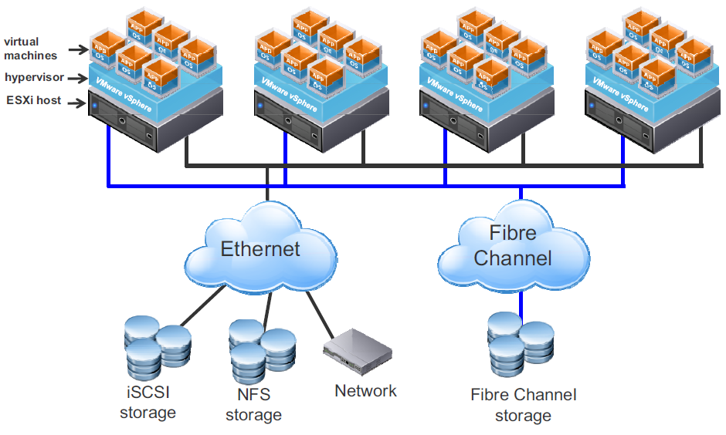
Infrastructure as a Service
iSCSI – Internet Small Computer Systems Interface
NFS – Network File System
Virtual Infrastructure Model
1-<number>
Notes:
An IaaS provider suppliers virtual machine images of different operating systems flavors.
These images can be tailored by the developer to run any custom or packages application.
These applications can run natively on the chosen OS and can be saved for a particular purpose.
The user can bring online and use instances of these virtual machine images when needed.
Use of these images is typically metered and charged in hour-long increments.

Slide 17
Infrastructure as a Service
IaaS is the simplest of cloud offerings
It provides a mechanism to take advantage of hardware and other physical resources without any capital investment
It removes the barrier of infrastructure costs to anyone – even you!
1-<number>
Notes:
Infrastructure as a service (IaaS) refers to online services that provide high-level APIs used to dereference various low-level details of underlying network infrastructure like physical computing resources, location, data partitioning, scaling, security, backup etc.

Slide 18
Infrastructure as a Service
Traditionally, operating systems and software run on a physical computer.
Several challenges exist to running a large number of physical servers in a data centre.
The model is not flexible and can be inefficient.
The planning and cost of proper infrastructure (square footage, rack space, power, cooling, cabling, and server provisioning) are but a few of the problems that IT staff must address.
1-<number>

Slide 19
Infrastructure as a Service
Typically, a 1:1 relationship exists between a physical computer and the software that it runs.
This relationship leaves most computers vastly underused.
The cost of the space and power required to house, run and keep these systems cool can be expensive.
Provisioning physical servers is a time consuming process.
1-<number>

Slide 20
Infrastructure as a Service
The reduction of physical machines can be realized by converting physical machines to virtual machines and consolidating the converted machines onto a single host.
Using virtualization technology also changes the way servers are provisioned.
You do not need to wait for the hardware to be procured or cabling to be installed.
Virtual machine provisioning is performed using an intuitive graphical user interface.
In contrast to the long process of deploying physical servers, deploying virtual machines can be deployed in a matter of minutes.
1-<number>

Slide 21
Infrastructure as a Service
Virtual Infrastructure Model
1-<number>

Slide 22
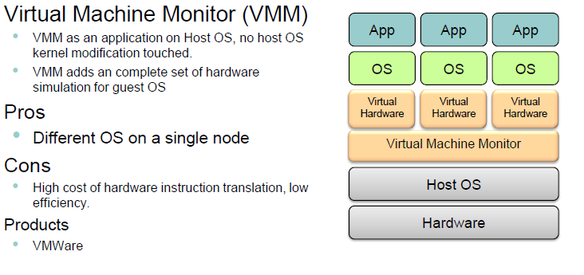
Infrastructure as a Service
.
1-<number>

Slide 23
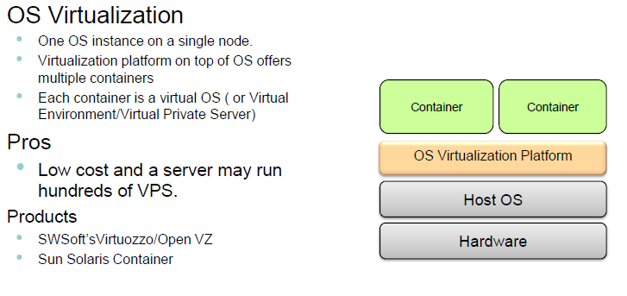
Infrastructure as a Service
OS virtualization:
1-<number>
Notes:
Operating system virtualization (OS virtualization) is a server virtualization technology that involves tailoring a standard operating system so that it can run different applications handled by multiple users on a single computer at a time.
The operating systems do not interfere with each other even though they are on the same computer.
In OS virtualization, the operating system is altered so that it operates like several different, individual systems.
The virtualized environment accepts commands from different users running different applications on the same machine.
The users and their requests are handled separately by the virtualized operating system.
Also known as operating system-level virtualization.

Slide 24
Infrastructure as a Service – Service Types
We can classify IaaS services broadly in terms of Servers, Storage and connectivity.
Servers: - allocation of computing resources – elastic – can be shared or dedicated
Storage – physical memory – elastic – SaaS delivery is obviously very important – cost of memory!
Connectivity- cloud is pointless without network connection.
Cloud offers network segmentation, load balancing based on network capability, security
1-<number>

Slide 25
Platform as a Service
Emerged from two main trends – suboptimal nature of IaaS and evolution of web applications.
Infrastructure service offers many benefits but the platforms that run on infrastructure service tend to have been designed for desktop / traditional client-server environments.
PaaS have been developed to facilitate faster time-to-market, a common user experience and an easier development environment.
1-<number>
Notes:
Platform as a Service (PaaS) or application platform as a Service (aPaaS) is a category of cloud computing services that provides a platform allowing customers to develop, run, and manage applications without the complexity of building and maintaining the infrastructure typically associated with developing and launching an app.
PaaS can be delivered in two ways: as a public cloud service from a provider, where the consumer controls software deployment with minimal configuration options, and the provider provides the networks, servers, storage, operating system (OS), middleware (e.g. Java runtime, .NET runtime, integration, etc.), database and other services to host the consumer's application; or as a private service (software or appliance) inside the firewall, or as software deployed on a public infrastructure as a service.

Slide 26
Platform as a Service
Cloud Platforms act as run-time environments that support a set of compiled / interpreted programming languages.
Some of the services offered are:
  Reusable components
  Libraries
  Application Programming Interfaces
  Work flow facilities for application design, dev., testing, deployment and hosting
  Collaboration services to supported distributed development
  Integration services (WS integration, marshalling, DB integration, concurrency management
  Source code services – version control, dynamic multiple user testing etc
1-<number>

Slide 27
Platform as a Service
Goal of PaaS in terms of cloud computing components is to enable
  (a) elasticity
  (b) Multi-tenancy
  (c) Rapid Prototyping
  (d) leverage web technologies .
To achieve the above goals PaaS vendors constraints::
  Only specific programming languages and run times are provided.
  Not all language/library features are enabled
  Generic APIs typically replace some of the features of traditional stacks
  There may be size constraints in terms of individual requests
  Statelessness is encouraged to minimize the overhead of state management.
1-<number>

Slide 28
Platform as a Service
In addition to the constraints, platform vendors provide:
  IDE plug-ins, SDKs and local emulation environments
  Frameworks
PaaS has advantages over traditional models in terms of platforms being located geographically distributed.
PaaS facilitates aggregation of different web services.
1-<number>

Slide 29
Platform as a Service
An example of PaaS is Google App Engine (GAE) from Google Cloud Platform
It allows developers to build and deploy web applications and APIs with ease.
It provides a basic runtime environment as well as eliminating system admin and scaling challenges that may exist for applications that can scale to millions of users.
Another example of a Platform that is similar in concept is Azure
It supports applications based on Microsoft technologies to be hosted and run from Microsoft data centres.
1-<number>

Slide 30
Software as a Service
Software as a Service unlike IaaS or PaaS provides a service that is already fully consumable by the end user, which is different from PaaS/IaaS which offer platforms/Infrastructure where applications can be installed.
SaaS provides the full stack of cloud services and the services provided should “appear” exactly as they would if developed in the traditional model.
So, how would a company make a profit on this?
1-<number>

Slide 31
Software as a Service
So, how would a company make a profit on this?
  Licensing (subscription based access)
  Usage (Tiered Pricing plans) – maybe after a free trial period
  Add-Ons and Upgrades (for premium features)
  Data Analytics and Insights (derive valuable insight from their data generated)
  Consulting and Training Services (to maximize the value of their SaaS)
  Etc…..
1-<number>

Slide 32
Software as a Service
Software as a Service offers a number of significant benefits.
  No need to worry about obtaining high utilization from your hardware
  Outsources tedious application maintenance
  Ties customer cost to usage
But:
  It does restrict customer flexibility in terms of configuration and update scheduling
  Merging to SaaS (or any *aaS) is a significant undertaking and requires planning
1-<number>

Slide 33
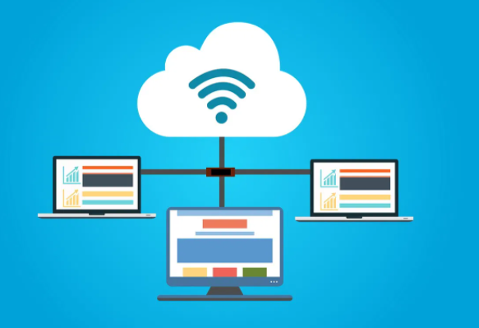
In Summary:
“Cloud is about how you do computing, not where you do computing” – Paul Maritz (CEO of VMware)
1-<number>

Slide 34
Optional Extra Slides based on Cloud Classification for the deployment of Microservices as part of a Cloud Native Application

Slide 35
Cloud Classification
IAAS
  Infrastructure as a Service
CAAS
  Container as a Service
PAAS
  Platform as a Service
FAAS
  Function as a Service
SAAS
  Software as a Service
DAAS
  Database as a Service
Notes:
Infrastructure as a Service (IaaS)—
Infrastructure is the infra layer that provides a platform of Operating System(OS),
Compute services, memory and persistence storage. It provides IP-based connectivity
Using TCP/IP, UDP and REST API services. It provides a bare-metal (BM) platform
Where applications can be deployed
– ie: IaaS platforms include AWS (EC2), Azure Virtual Machines, Google Compute
Engine, and Kubernetes.
USE CASE: Organization wants to manage their infrastructure on their own from the hardware
Layer to OS and runtime.
Container as a Service (CaaS)—
Container is a new IaaS for cloud native modern applications
An intermediate model between the IaaS and the
PaaS, it refers to a form of container-based virtualization.
Container is an executable unit/bundle of software in which application binary code is
Packaged. CaaS provides a platform to deploy, run, and manage software applications as containers.
USE CASE: Run apps on smaller containers on top of bare-metal/hypervisor infrastructure.
Platform as a Service (PaaS)—This model provides a platform and an environment
that allow users to focus on the development, execution, and maintenance
of the application. The applications can be created with tools that are
provided by the vendor (for example, operating system, database management
systems, technical support, storage, hosting, network, and more). Users do not
need to invest in a physical infrastructure, nor spend time managing it, allowing
them to concentrate exclusively on the development of applications.
PaaS platforms include Google App Engine, Cloud Foundry, Heroku, and
AWS Elastic Beanstalk
USE CASE: Faster release to compete in market.
No vendor lock-in for backend and middleware software on cloud, because
same PaaS software platforms manage your apps, database, and infra on
multi-clouds on private, hybrid and public clouds –
ie: Amazon AWS, Google GCP and Microsoft Azure.
Function as a Service (FaaS)—
Provides a platform where service providers manage all the servers
infrastructure automatically for organizations by using an event driven model.
Its an on-demand with managed services that allows execution of microservices
through API. Public cloud charges pay as you go. FaaS saves infrastructure cost by
Only spinning servers for a shorter duration on demand, for example executing a batch
Job at a scheduled time or short-lived services. It hides all infra-abstractions.
USE CASE: good choice for short-lived microservices, good for event driven microservices
architecture model.
Software as a Service (SaaS)—
Provides ready to use software on cloud on the internet based on subscription.
Many suppliers(business) are doing business by deploying these software on cloud and
Exposing them to end users on paid subscription.
Ie: Google services like Google search, google drive, Microsoft office 360, zoom etc.
USE CASE: subscription based cloud services. Ready made services like e-mail service using MailChimp.
Database as a Service –
It’s a subset of SaaS that provides SQL/NoSQL databases as a service on cloud through the internet.
It provides strong security, performance backup, easy scalability, database upgrades,
Its also called managed services, deployed on the cloud and accessed via REST APIs.
Ie: AWS RDS is a popular database as a service.
USE CASE: outsource database to avoid operational and scaling cost.

Slide 36
Cloud Classification
Infrastructure as a Service (IaaS)—
Infrastructure is the infra layer that provides a platform of Operating System(OS),Compute services, memory and persistence storage.
It provides IP-based connectivity using TCP/IP, UDP and REST API services. It provides a bare-metal (BM) platform where applications can be deployed
– ie: IaaS platforms include AWS (EC2), Azure Virtual Machines, Google ComputeEngine.
USE CASE: Organization wants to manage their infrastructure on their own from the hardware layer to OS and runtime.
Container as a Service (CaaS)—
Container is a new IaaS for cloud native modern applications
An intermediate model between the IaaS and the PaaS, it refers to a form of container-based virtualization. Container is an executable unit/bundle of software in which application binary code is packaged. CaaS provides a platform to deploy, run, and manage software applications as containers.
USE CASE: Run apps on smaller containers on top of bare-metal/hypervisor infrastructure.

Slide 37
Cloud Classification
Platform as a Service (PaaS)—
This model provides a platform and an environment that allow users to focus on the development, execution, and maintenance of the application.
The applications can be created with tools that are provided by the vendor (for example, operating system, database management systems, technical support, storage, hosting, network, and more).
Users do not need to invest in a physical infrastructure, nor spend time managing it, allowing them to concentrate exclusively on the development of applications.
PaaS platforms include Google App Engine, Cloud Foundry, Heroku, and AWS Elastic Beanstalk
USE CASE: Faster release to compete in market. No vendor lock-in for backend and middleware software on cloud, because PaaS software platforms manage your apps, database, and infra on multi-clouds on private, hybrid and public clouds –
ie: Amazon AWS, Google GCP and Microsoft Azure.

Slide 38
Cloud Classification
Function as a Service (FaaS)—
Provides a platform where service providers manage all the servers infrastructure automatically for organizations by using an event driven model. Its an on-demand with managed services that allows execution of microservices through API. Public cloud charges pay as you go. FaaS saves infrastructure cost by only spinning servers for a shorter duration on demand, for example executing a batch job at a scheduled time or short-lived services. It hides all infra-abstractions.
USE CASE: good choice for short-lived microservices, good for event driven microservices architecture model.
Software as a Service (SaaS)—
Provides ready to use software on cloud on the internet based on subscription. Many suppliers(business) are doing business by deploying these software on cloud and exposing them to end users on paid subscription.
Ie: Google services like Google search / drive, Microsoft office 360, zoom etc.
USE CASE: subscription based cloud services. Ready made services like e-mail service using MailChimp.

Slide 39
Cloud Classification
Database as a Service –
It’s a subset of SaaS that provides SQL/NoSQL databases as a service on cloud through the internet.
It provides strong security, performance backup, easy scalability, database upgrades, its also called managed services, deployed on the cloud and accessed via REST APIs.
Ie: AWS RDS is a popular database as a service.
USE CASE: outsource database to avoid operational and scaling cost.

Slide 40
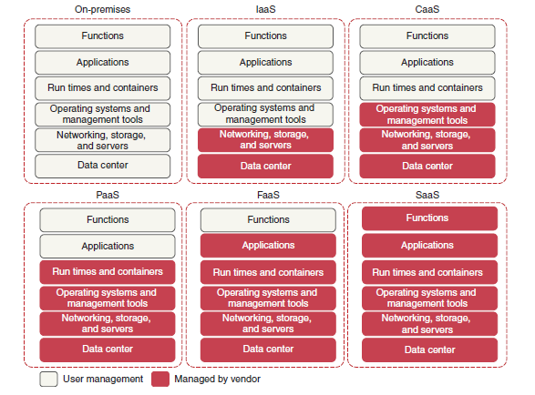
Cloud Computing

Slide 41
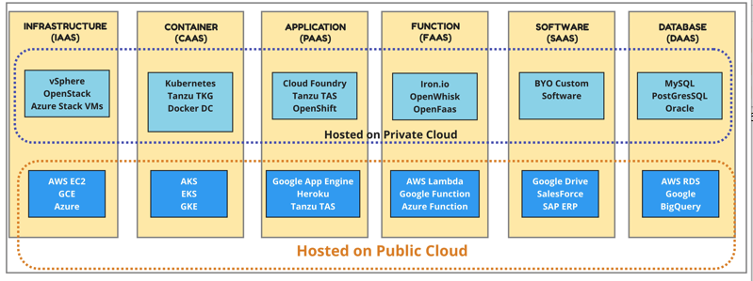
Cloud Classifications
Cloud Classification with some related reference technologies and services of service providers
Notes:
An Amazon EC2 instance is a virtual server in Amazon's Elastic Compute Cloud (EC2) for
running applications on the Amazon Web Services (AWS) infrastructure.
AWS is a comprehensive, evolving cloud computing platform;
EC2 is a service that enables business subscribers to run application programs in the computing environment.

